Slide 1
The Generic American Inn of Court
New Member Orientation
July 23, 2026

Slide 2

Welcome!
Notes:
RECOMMENDED TALKING POINTS:
Welcome them.

Slide 3
New Members
Tell us your…
Name
Practice
One thing you are looking forward to as a member of the Inn
Notes:
RECOMMENDED TALKING POINTS:
One of the things that makes an Inn of Court special is the more intimate nature of the community.
In our Inn, people are known as individuals, rather than positions or representatives of some body or function.
To strengthen our community, we would like to get to know you better.

Slide 4
Executive Committee
Abraham Lincoln, President
2025-2027
Hannibal Hamlin, Vice President/President Elect
2026-2028
William Seward, Secretary
2050-2027
Salmon Chase, Treasurer
2026-2028
Notes:
RECOMMENDED TALKING POINTS:
List current executive committee members’ names, positions, and term limits.
The executive committee administers the Inn and concerns itself with delivering a high-quality experience for its members.
If you have questions or suggestions, please reach out to your executive committee.
If you would like to be more involved in the Inn, please reach out to the appropriate committee member.

Slide 5
Orientation Agenda
What are the American Inns of Court?
Introduction to the Generic American Inn of Court
Your Member Experience
Plans for the Inn Year
Notes:
RECOMMENDED TALKING POINTS:
This is what we will be covering today.
You all have packets in front of you; we will be referencing resources in those packets throughout the orientation.
If you have questions, please raise your hand/wait until the designated Q&A period.

Slide 6
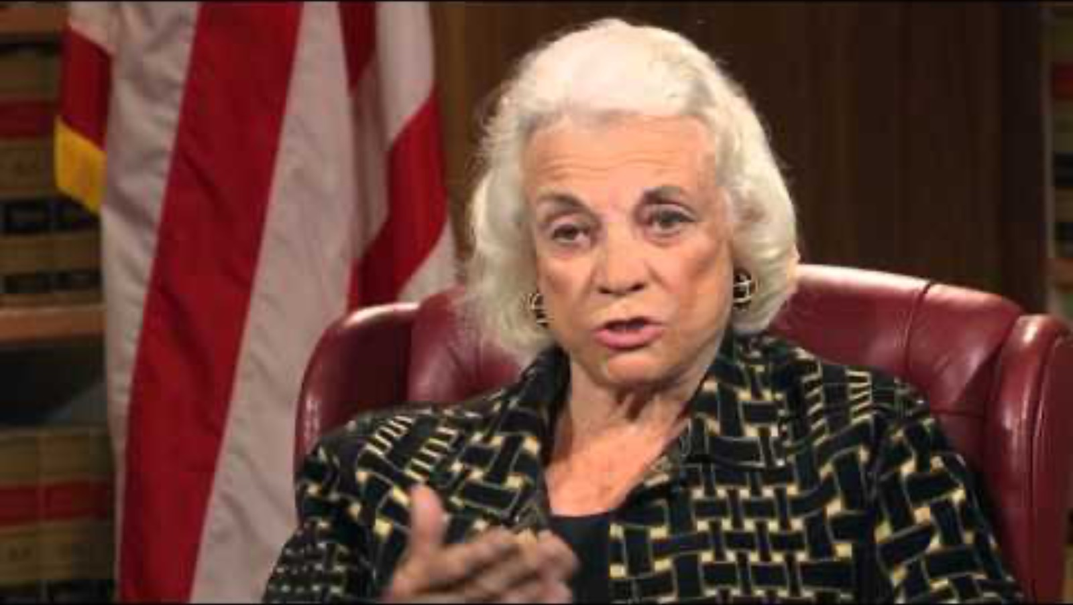
Origins of the
American Inns of Court
Notes:
RECOMMENDED TALKING POINTS:
Since its incorporation in 1985, the American Inns of Court has worked to promote the civility and professional standards necessary for a properly functioning bar.
You are joining a national movement that has its roots in the English Inns of Court of the 14th Century.
LINK TO VIDEO: https://youtu.be/hLmByCqjFe8

Slide 7
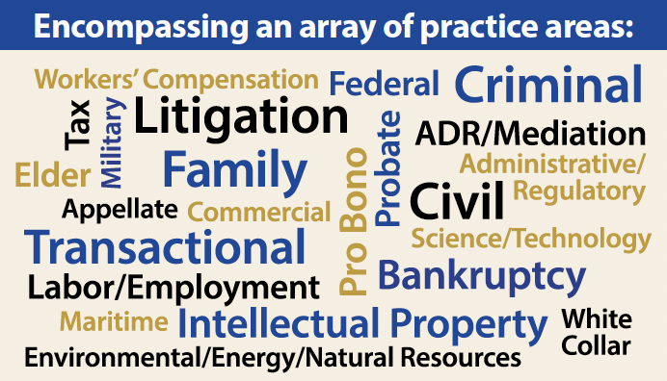
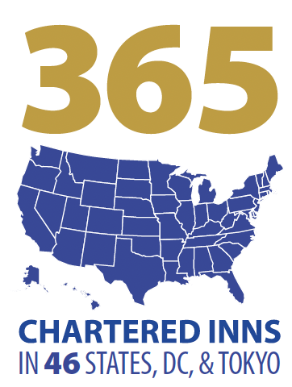
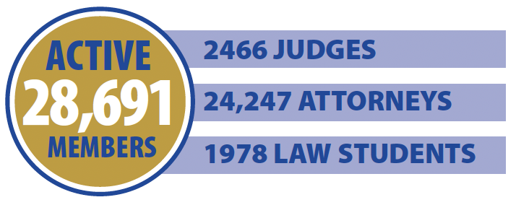
By The Numbers
Notes:
RECOMMENDED TALKING POINTS:
Since its incorporation in 1985, the American Inns of Court has worked to promote the civility and professional standards necessary for a properly functioning bar.
You are joining a national movement that has its roots in the English Inns of Court of the 14th Century.
Currently, there are over 30,000 active members in over 350 chartered Inns across 46 states, DC, Guam, and Tokyo.
Notable members include:
Chief Justice Roberts
Retired Justice Kennedy
Retired Justice O’Connor
Justice Alito
Justice Ginsburg
Justice Gorsuch
Justice Kavanaugh
Justice Thomas
Plus over 60 appellate court judges.
And Inns are affiliated with over 170 law schools nationwide.
You can read more about the impact of the American Inns of Court in the "American Inns of Court: By the Numbers" document in your packet.

Slide 8
The American Inns of Court
Mission
The American Inns of Court inspire the legal community to advance the rule of law by achieving the highest level of professionalism through example, education, and mentoring.
Vision
A legal profession and judiciary dedicated to professionalism, ethics, civility, and excellence.
Notes:
RECOMMENDED TALKING POINTS:
The mission and vision of the American Inns of Court is what our Inn and all its members uphold and stand for.
Across the nation, the American Inns of Court:
Brings lawyers, judges, and law students together,
Intentionally structures an environment to maximize mentoring, education, and developing professional relationships, and
Focuses strongly on professionalism, ethics, civility, and excellence.

Slide 9
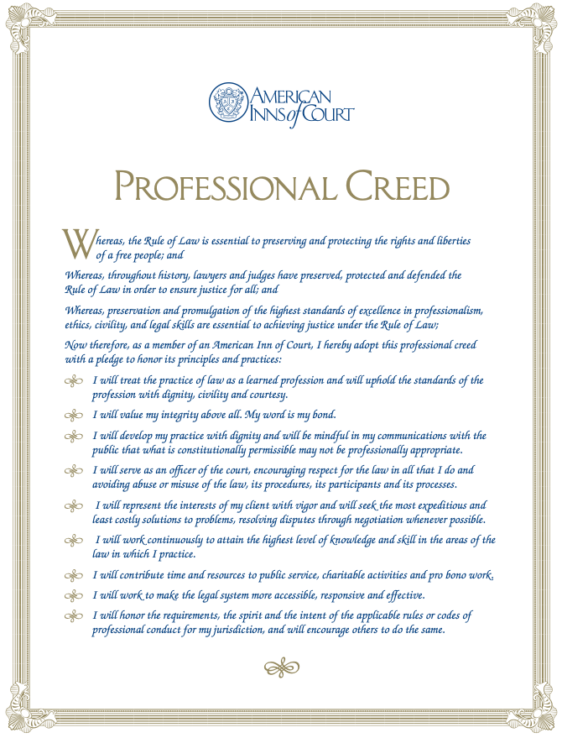
The American Inns of Court Professional Creed
Notes:
RECOMMENDED TALKING POINTS:
As a member of an American Inn of Court, specifically the Generic American Inn of Court, we want to ensure that all our members understand the importance of our core values.
We find inherent and long-lasting value in practicing the law with professionalism, ethics and collegiality.
Please refer to the printed copy [in your member packet/handout] of our Professional Creed.
Please review it; we’d like you to adopt this creed as a member of this Inn.
Together, “As a member of an American Inn of Court, I [state your name] hereby adopt this professional creed with a pledge to honor its principles and practices.”

Slide 10

The Generic
American Inn of Court
[Include Inn photo or crest here]
The nth Inn chartered (of more than 500 to date)
The nth Inn chartered in [state]
Chartered in [year]
Founding members include…
Achieving Excellence [status] since [year]
Notes:
RECOMMENDED TALKING POINTS:
Include facts about your Inn’s history and founding here.
The bullet points on this slide are suggestions.
If you have questions about your Inn’s history, contact your Director of Chapter Relations.
Take this opportunity to recognize founders, namesakes, and Inn “champions” present.

Slide 11

Member Expectations
Our commitment to you:
people, experience, and programs
Notes:
RECOMMENDED TALKING POINTS:
Briefly outline major policies and procedures for the Inn.
Include why policies exist. For example, there is an attendance policy because the Inn prioritizes the commitment of its members and there is a waiting list of potential members.
The list on the slide gives some examples, but feel free to add more.
Share how your Inn delivers the following:
Impact on People
Connection: We are the only place where the Bench and Bar come together through local programs to collaborate, share knowledge, and develop relationships that lead to professional and personal growth.
Collegiality: We are a welcoming, engaging, and passionate community of legal professionals fostering career growth and discovery.
Impact on Experience
Mentorship: We are a trusted source for unparalleled career support and life-long mentoring that challenge our members to grow, connect and give back to the profession.
Respect: For more than 45 years, the American Inns of Court has been driving the standard of excellence, civility, and professionalism in the legal profession.
Feedback: We regularly survey our members about their Inn experience and incorporate your feedback to improve our operations and offerings.
Impact on Programs
Education: For decades, the legal profession has relied on AIC to develop future leaders through progressive, accessible, and quality education that fosters respect, ethics, and excellence.
Innovation: We inspire our members – and the profession – through innovative learning opportunities and cutting-edge content that ensures ongoing excellence and professionalism in the field.

Slide 12

Member Opportunities
Notes:
RECOMMENDED TALKING POINTS:
Tie the opportunity to the value the member will receive: how will the activity benefit them?
Networking:
Our Inn hosts a networking hour before/after the program where you can meet lawyers and judges from all walks of life. The informal conversations you have with members of this Inn could be some of the most formative you have in your professional career.
Pupillage teams:
Pupillage teams are responsible for planning monthly programs. Within your team are more opportunities for networking, mentoring, and developing leadership skills.
Mentoring:
Mentoring the next generation in professionalism, civility, and respect is what the American Inns of Court are all about. Describe your Inn's mentoring program/opportunities.
Leadership:
The Executive Committee [membership committee, program committee, etc.] is always on the lookout for dedicated, talented individuals to continue our Inn's strong legacy. Volunteering your time to the American Inns of Court can develop transferrable skills to help you in your practice, and it puts you in contact with other leaders in the field.
Outreach:
If your Inn has an outreach program, explain how members can get involved or how they might suggest organizations/causes to support.

Slide 13
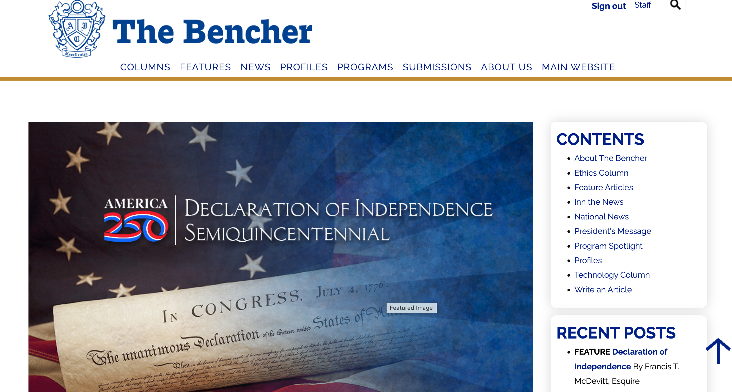
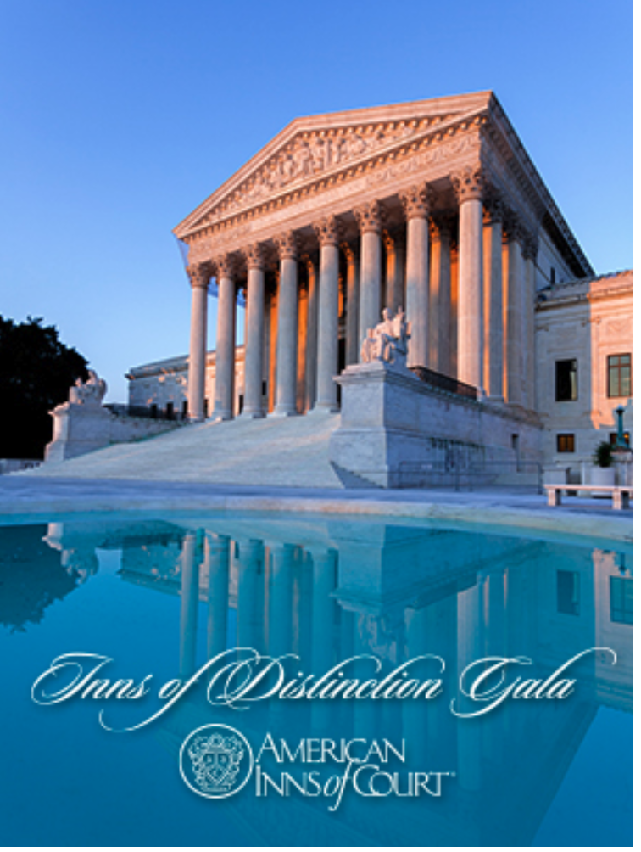
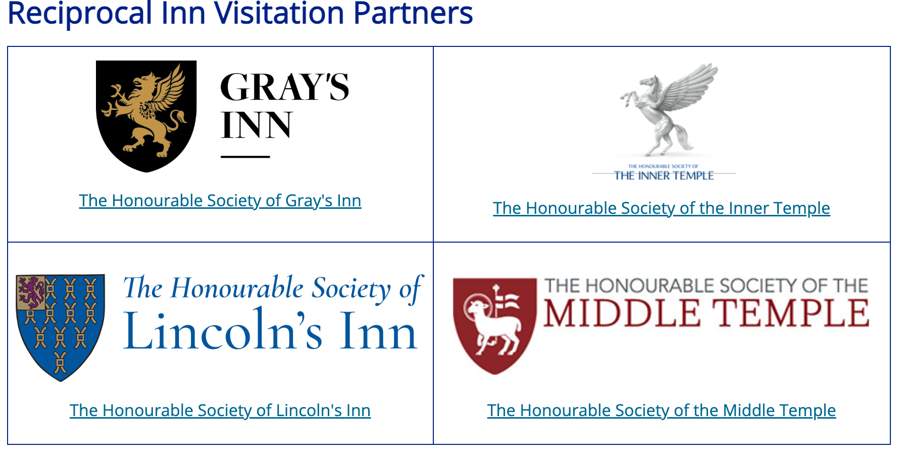
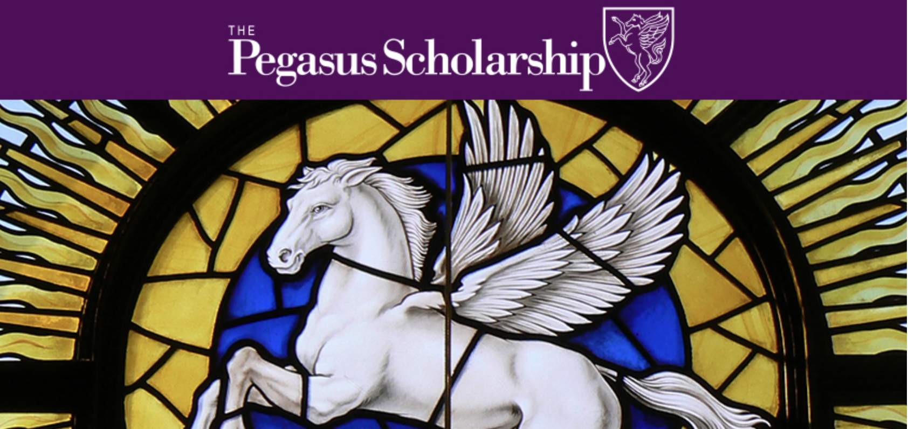
National Member Benefits
Notes:
RECOMMENDED TALKING POINTS:
As a member of the Generic Inn, you are automatically a member of the national American Inns of Court organization. In addition to the experience you enjoy at your regular meetings, you can also take advantage of national member benefits.
•The Bencher®, a bimonthly magazine with articles on professionalism, ethics, timely topics, and Inn news- NOW ONLINE- https://www.innsofcourt.org/bencher
•An online Membership Directory to network with Inn members across the country
•Exclusive eligibility for Pegasus Scholarships, as well as the Sandra Day O’Connor Award for Professional Service and A. Sherman Christensen Award, presented annually at the Supreme Court of the United States
*Letters of introduction to facilitate visits to the English and Irish Inns of Court
*Volunteer and leadership development opportunities through Inn and national board service, committees and task force participation
*Opportunities to attend the Inns of Distinction Gala and the Celebration of Excellence at the Supreme Court of the United States
We encourage you to access the national website: www.innsofcourt.org. This will help you get the most out of your membership.

Slide 14
Up Next
Next meeting: MM/DD/YY
  Topic
  Location
Mentoring groups forming
Pupillage team assignments
Outreach program: Save-the-Date
Need volunteers for XX.
Notes:
RECOMMENDED TALKING POINTS:
These are suggestions; add whatever activities your Inn is engaged in.

Slide 15
Questions? Contact Us
Inn Leaders
[List a contact on the executive committee or central Inn email where members can contact the local Inn]
American Inns of Court National Office
(703) 684-3590
info@innsofcourt.org
Notes:
RECOMMENDED TALKING POINTS:
We want you to get the most out of your experience with the Generic American Inn of Court.
If you have questions about any aspect of your national membership, feel free to contact the American Inns of Court office directly.
If you have any questions about what is going on locally, your role, how you can get more involved, etc. please reach out to [XX].

Slide 16
Thank you and welcome to the American Inns of Court!

